Slide 1
Passenger Friendly RTC

Slide 2
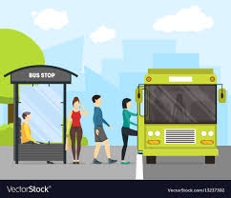
Problem Statement
Difficulty in traveling by RTC city buses due to uncertain bus timings.

Slide 3
Target Customers
Daily Passengers in the City.
Tourists visiting the City.
Revenue from Advertisements.

Slide 4
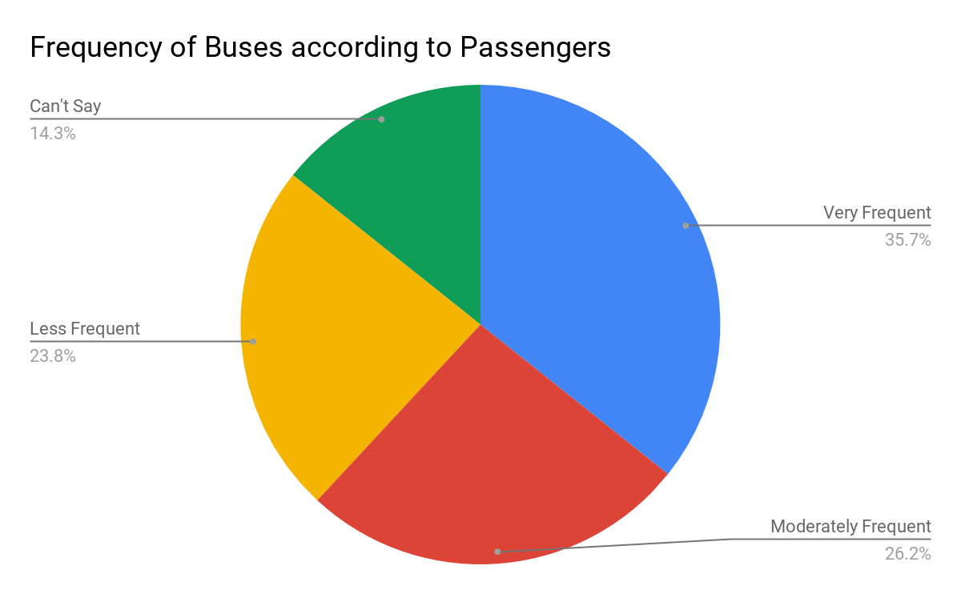
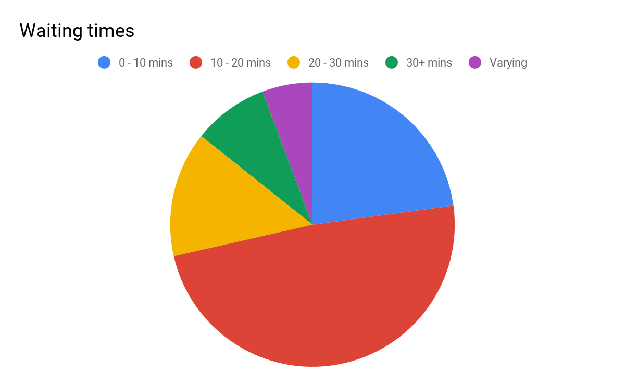
Market Research
Daily passengers having infrequent buses in their routes face the problem to larger extent.
Nearly 75% of the people we approached say our product would help them a lot.

Slide 5
Our Solution
Our product takes user destination as input.
Shows all the buses arriving him/her in next few minutes along with estimated destination reach time.

Slide 6
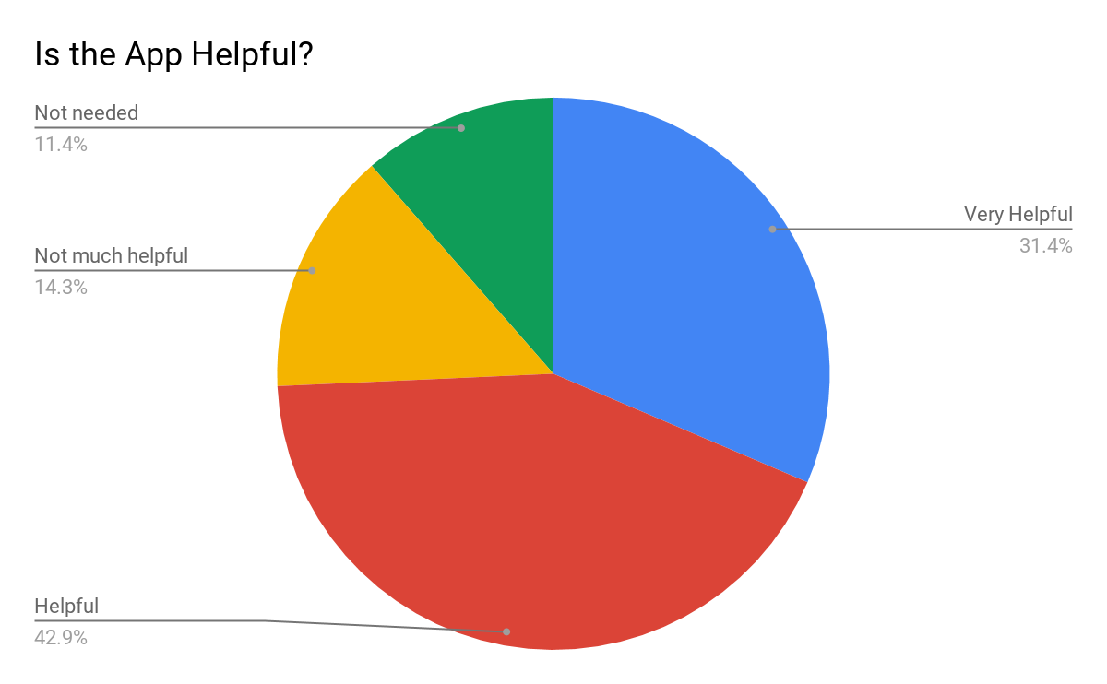

Slide 7
Competitors
Other applications on Google Play Store like “Hyderabad RTC”, which show a fixed schedule of when a bus starts from its source.

Slide 8
My Team
PVS Harshith
P Mukul Paras

Slide 9
Thank You!!

